Slide 1
HeteroMed: Heterogeneous Information Network for Medical Diagnosis
Source : CIKM 2018
Advisor : JIA-LING KOH
Speaker : YI-CHENG HUNG
Date:2019/03/04

Slide 2
Outline
Introduction
Method
Experiment
Conclusion

Slide 3
Outline
Introduction
Method
Experiment
Conclusion

Slide 4
Introduction

Slide 5
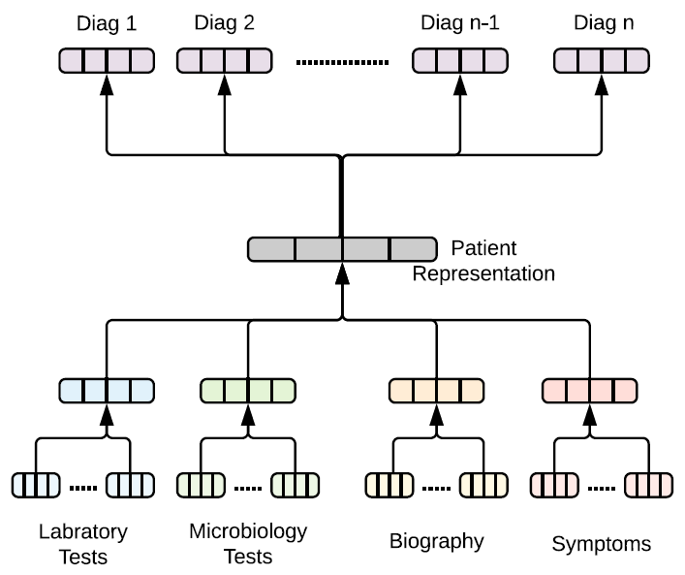
Diagnosis prediction flow

Slide 6
Outline
Introduction
Method
Experiment
Conclusion

Slide 7
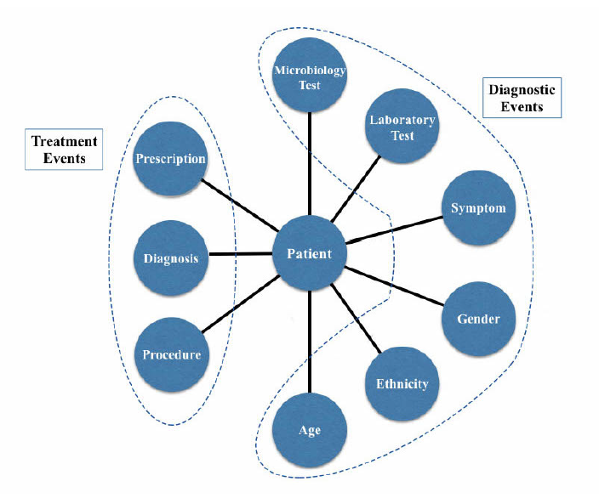
Problem Deinition and Clinical Terminology

Slide 8
EHR heterogeneous network schema

Slide 9
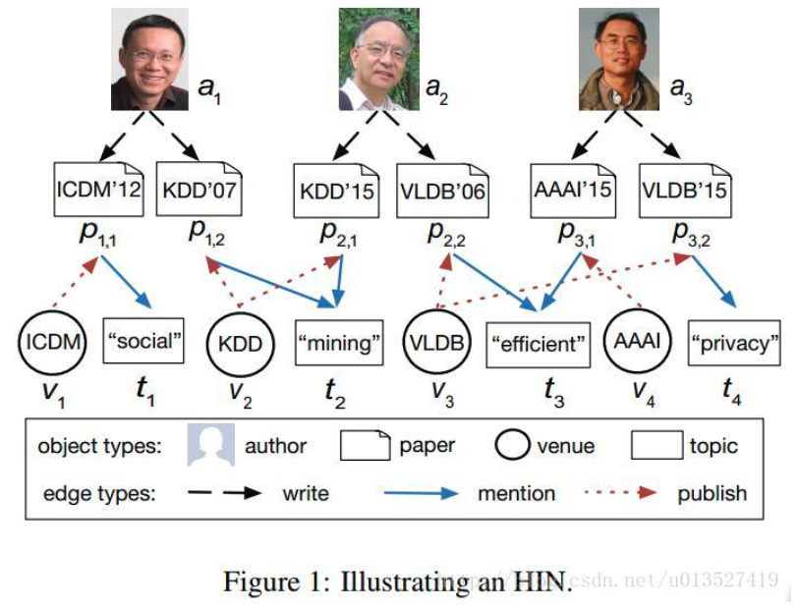
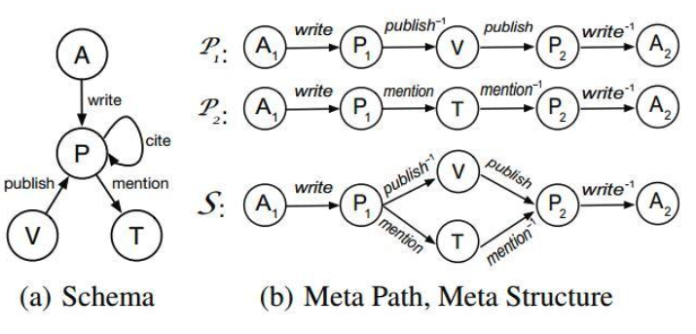
MetaPath-instance

Slide 10
Heterogeneous Network Embedding for Clinical Events

Slide 11
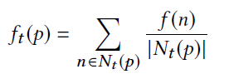
Diagnosis Prediction

Slide 12
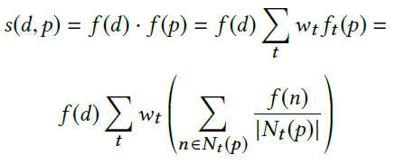
Supervised Node Representation Learning for Diagnosis Prediction
NEW object:

Slide 13
Joint Objective

Slide 14
Outline
Introduction
Method
Experiment
Conclusion

Slide 15
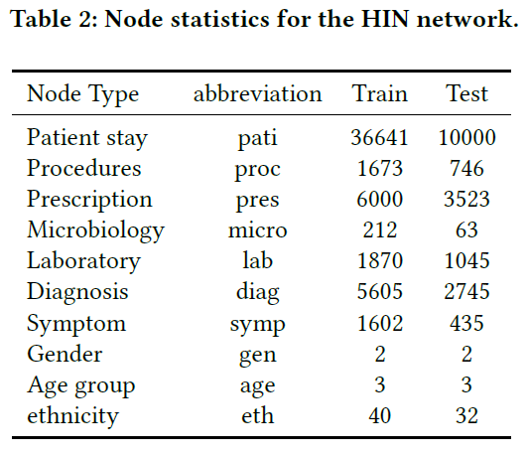
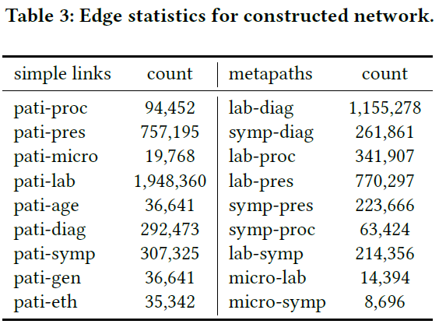
Dataset

Slide 16
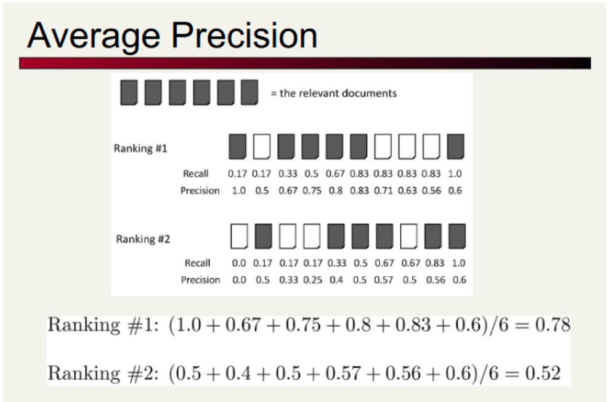
Evaluation Strategies
MAP
AUROC

Slide 17
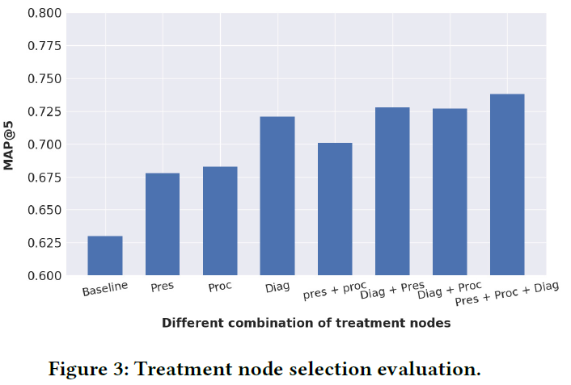
Treatment Node Selection.

Slide 18
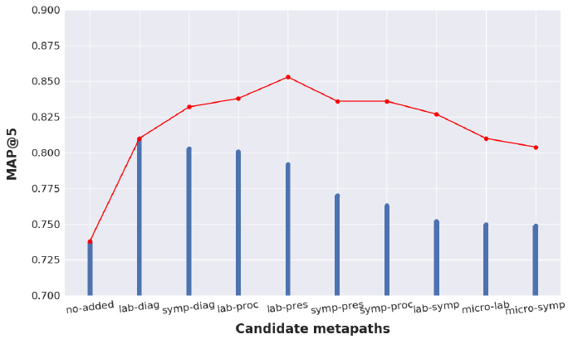
Metapath Selection

Slide 19
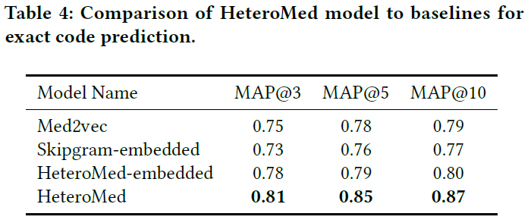
Exact Code Prediction

Slide 20
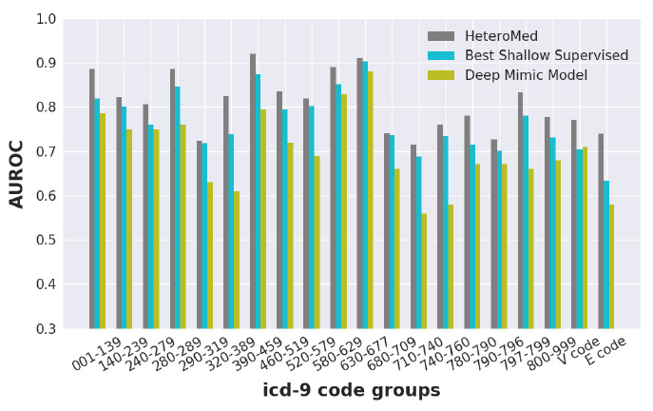
Disease Cohort Prediction.

Slide 21
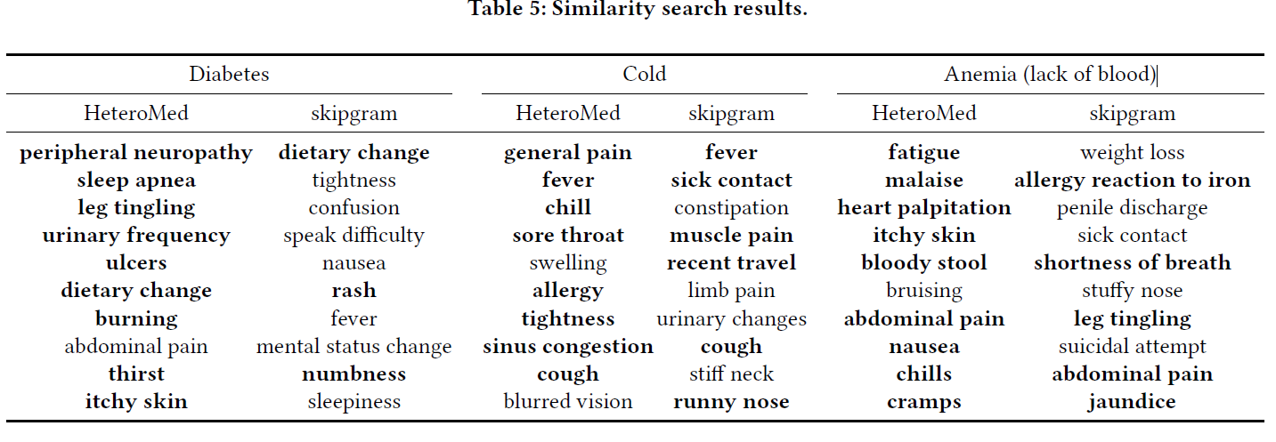
Case Studies

Slide 22
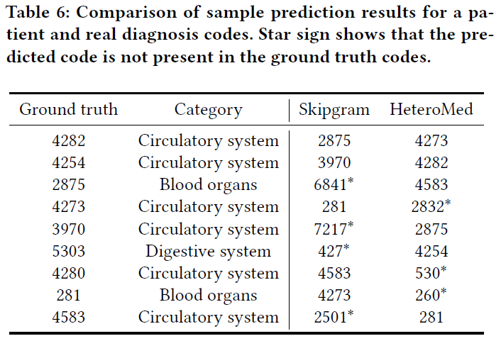
Case Studies

Slide 23
CONCLUSION
HeteroMed is capable of capturing informative relations for the diagnosis goal
HeteroMed can achieve significantly better results in diagnosis task and finding clinical similarities
This in turn confirms the benefits of employing heterogeneous information network in modeling clinical data.

